Slide 2
CAST Academy at Balboa High School
A California Partnerships Academy
in the
Arts and Entertainment Industry Sector

Slide 3
Creating an Arts, Media, Entertainment Partnership with Purpose
Working with Outside Programs, Individuals, Institutions and Organizations to meet the CPA/CTE Standards and Requirements

Slide 4
Overview
Introductions
Activity
What are the Purposes of a Partnership?
Key Steps in Building a Partnership
Components of a Successful Partnership
Examples of Effective Partnerships in the CAST Academy
What can Teachers and Administrators Take Away from Today?
What are Benefits for Students, Teachers, Schools, and Districts?
What are Benefits for Partner Individuals, Organizations, or Institutions?
Conclusion/Questions

Slide 5
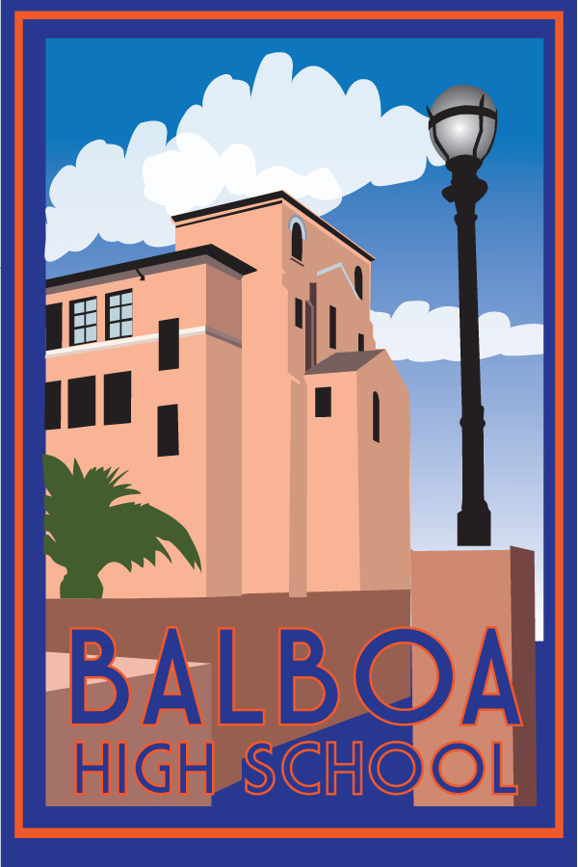
Balboa High School and CAST Academy
Reconstituted Comprehensive San Francisco Public High School
Ethnically and Economically Diverse Population
School Gains/Improvements
Wall to Wall Academies/Pathways
CAST History Highlights

Slide 6
Activity
Think of a partnership you have built in the past or currently have and identify what you think is a successful element of this partnership.
If you don’t have a partnership, think of one you would like to form, and what is one thing you think you need to do to move forward with building it.
Please introduce yourself and share with someone nearby who you don’t already know.

Slide 7
What are the Purposes of a Partnership?
Academic
Career Related
Technical Related
Mentor Students and Teachers
Meet CPA/CTE Standards

Slide 8
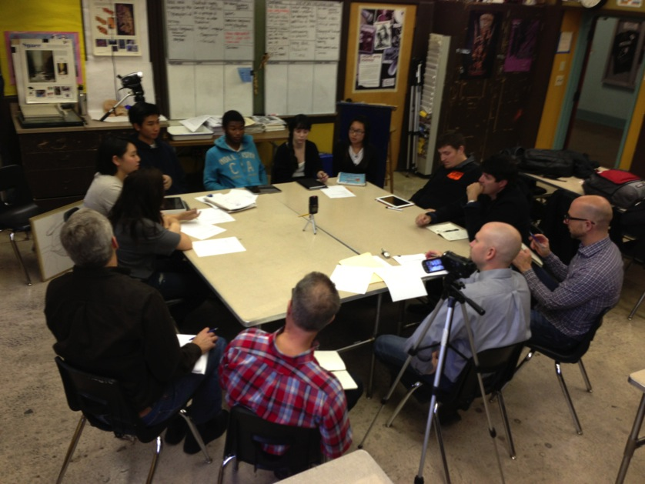
Key Steps in Building and Maintaining a Partnership
Contact
Communication
Collaboration
Inspiration
Creation
Showcasing
Reflection

Slide 9
Components of an Effective Partnership
Strong Curriculum/Shared Vision
Timeline for Implementation
Classroom Visits/Site Visits
Mentoring
Concrete Project Goals and Objectives
Showcasing Work/Community Engagement

Slide 10
Examples of Successful Partnerships from the CAST Academy
BAVC (Bay Area Video Coalition) (Lee)
Young CA Writers Project (Dave/Simpson)
Walt Disney Family Museum (Larson)
SFMOMA (All)
YEF Project (Navarro)
Adobe Youth Voices (Larson/Lee/Cogley)

Slide 11
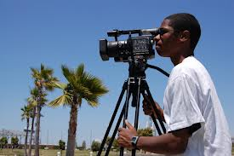
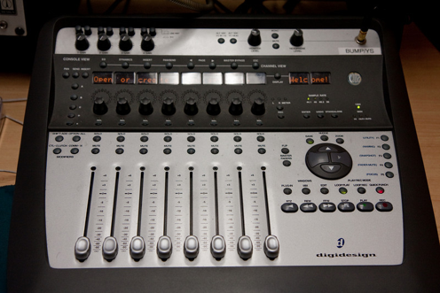
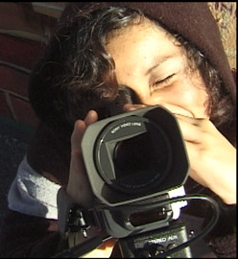
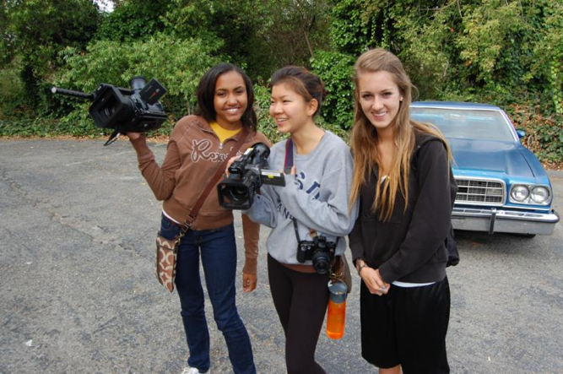
BAVC (Bay Area Video Coalition)

Slide 12
Young California Playwrights Project

Slide 13
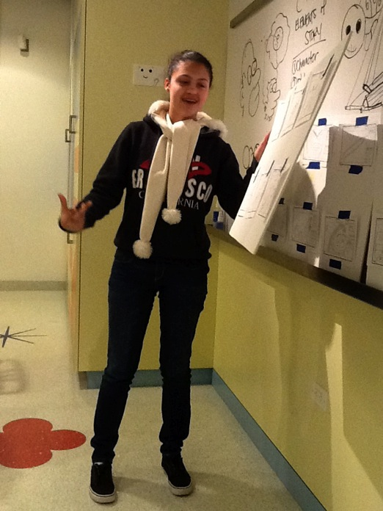
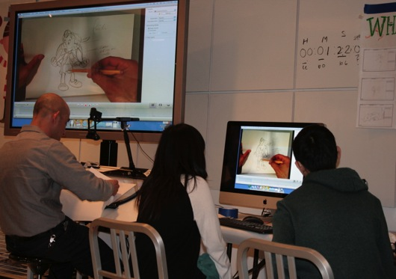
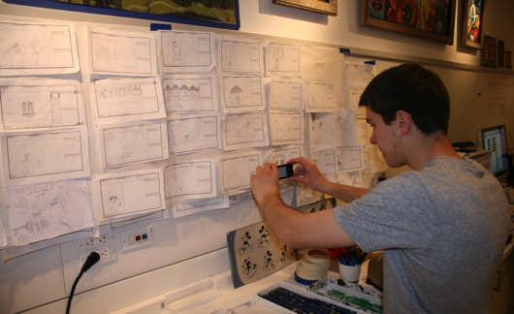
Walt Disney Family Museum Pilot Program

Slide 14
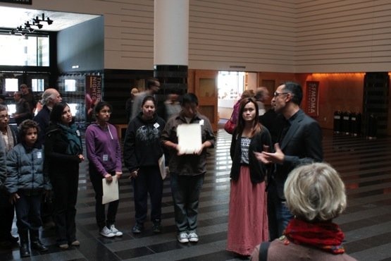
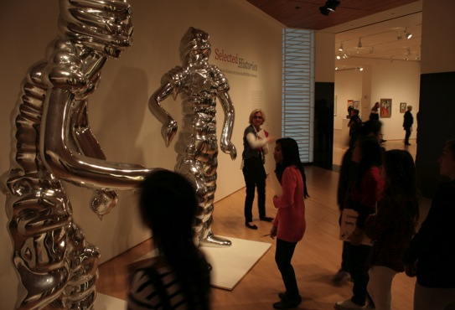
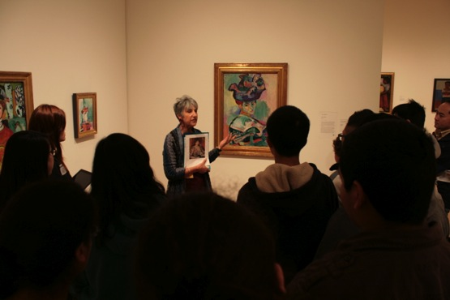
SFMOMA (San Francisco Museum of Modern Art) Young Curators

Slide 15
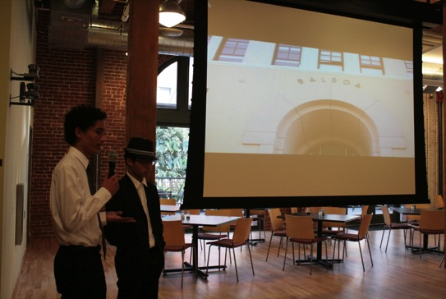
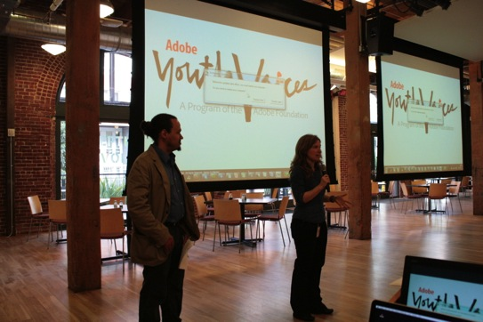
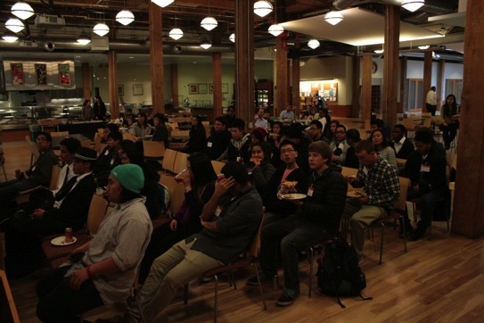
Adobe Youth Voices

Slide 16
What Can Teachers and Administrators Take Away From this Presentation?
Think about where to start given your situation.
Identify who you can work with in your area.
Consider how to support the work or projects.
It all starts with one successful project or collaboration. Continue to build and add more.
Partnerships create interest and enthusiasm.

Slide 17
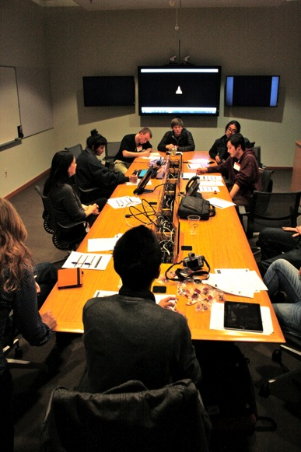
What are the Benefits for Students, Teachers, School, and Districts to Build Partnerships?
Chance to build working relationships with professionals, institutions, and groups.
An opportunity to be innovative and create a new program, project, and lessons.
Opportunities for students to have meaningful work- based experiences and site visits.
A way for students to apply their academic and technical skills in a dynamic and engaging way.

Slide 18
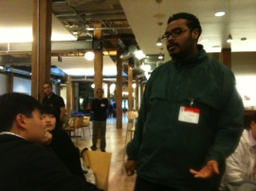
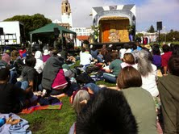
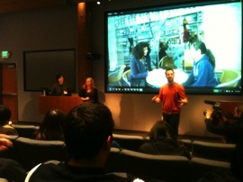
What are the benefits for partner individuals, organizations, or institutions?
Engagement with the education system, community, and young people.
A chance to develop their own educational materials and programs.
Provide meaningful career related experiences for students moving into workforce.
Opportunity to raise their own visibility in the town, city, or state.

Slide 19
Conclusion
Partnerships are worth the time and energy it takes to plan, develop, and implement.
Partnerships are key to helping successfully meet the CTE and CPA Standards and Requirements.
Creating effective partnerships can lead to new opportunities for all parties involved.
Partnerships provide purpose, direction, and focus for pathways and academies.

Slide 20
Questions and Answers
Contacts:
Minu Dave msminu@gmail.com
Jeff Larson jlarson.arted@gmail.com
George Lee gcreative@gmail.com
Melinda Simpson melindasharee@gmail.com
Anthony Navarro anthonycastelnavarro@gmail.com
Patricia Cogley pcogley@adobe.com

